Slide 1


Slide 2
All About BPM – Leader In BPM PEGA
About BPM
Business process management (BPM) is a methodology to manage processes and workflows in an organization
The goal of BPM is to increase efficiency, performance, and agility in the day-to-day operations of a business
BPM has been widely adopted by organizations and is essential for any enterprise businesses that want to be competitive in today’s marketplace
BPM Leader - PEGA
Pega adopted fully end to end BPMN capabilities and making continuous progress to support rapid technology changes happening around CRM and BPM space
Pega is offering the powerful / proven capabilities to support Citizen & Rapid Development , Declarative Design Patterns to quickly implement business requirements, Continuous Integration and Continuous Deployment
Pega is currently being used by fortune 500 companies because of it’s proven technical trends / capabilities / features

Slide 3
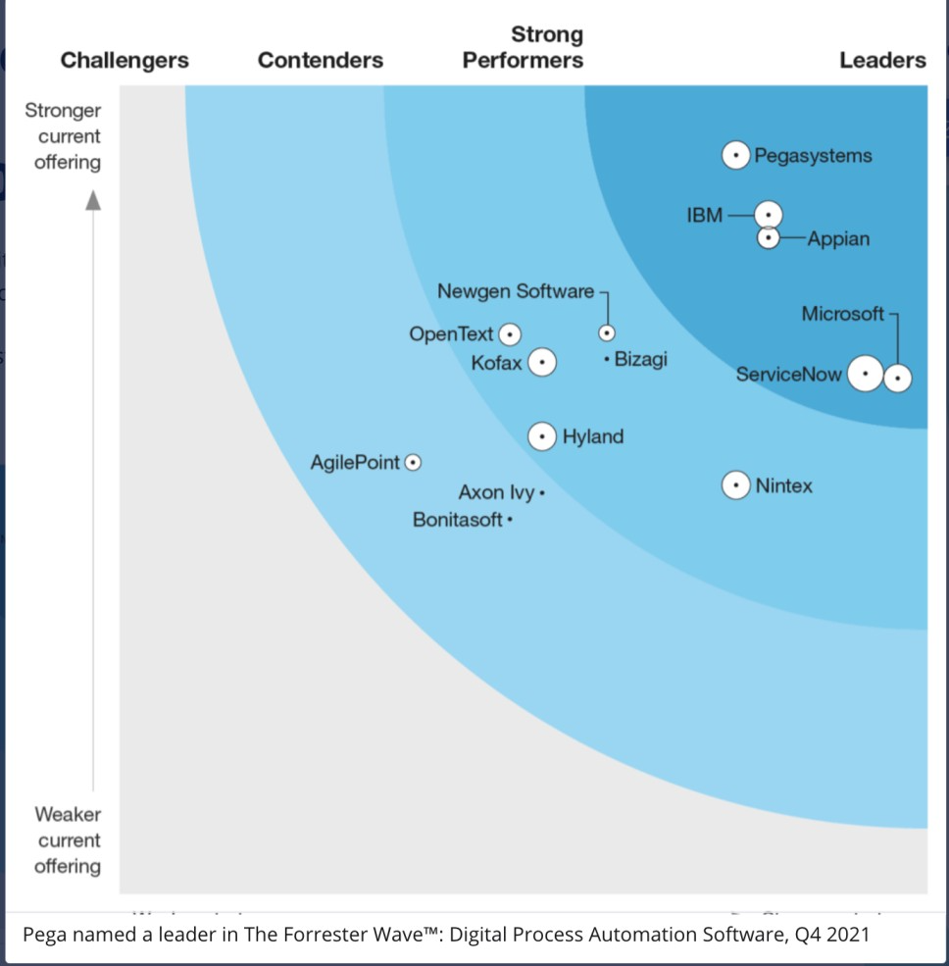
Gartner Forrester BPM Ranking - 2022
Gartner Forrester BPM Ranking - 2022

Slide 4
OVERVIEW
1. Low Code Platform
2. Middle Of The Approach
Pega
3. Process Driven Architecture
4. Omni Channel Presence
5. Microservice Architecture
6. Powerful CRM and AI Engine
7. Solid Security Design
7. Cross Industry Frameworks

Slide 5




Low Code Platform
01 Change
02 Configuration
03 Declarative
Build for change
Easy Configurations
Power Declarative Designs
04 App Studio
05 App Factory
05 Reusable Components
Rapid Development
Native user experience
Plug and Play Features

Slide 6
Middle Of The Approach
Overcome Top - Down Approach Challenges
Overcome Bottom – Up Approach Challenges
Fit Pega Middle In Overall Landscape
Future Ready Design Patterns
Adapters
Connectors
Micro Services
Starter Kits

Slide 7
Process Driven Architecture
01
Micro Journey Architecture Adoption
02
Proven & Powerful Case Management Capabilities
Process
Personas Based Approach
03
Pluggable BPMN Components
04
Citizen User Friendly Process Configurations
05

Slide 8
Omni Channel Presence

Slide 9

Micro Services Architecture
Asdasd
Asd
Asd
As
D
As
Da
Sd
As
D
As
D
As
D
Asddas

Slide 10


Powerful CRM & AI Engine

Slide 11




Solid Security Design

Slide 12
Cross Industry Frameworks

Slide 13
Other BPM’s Comparision

